Slide 1
Control Engineering I
Signal Flow Graphs

Slide 2
Introduction
Alternative method to block diagram representation, developed by Samuel Jefferson Mason.
Advantage: the availability of a flow graph gain formula, also called Mason’s gain formula.
A signal-flow graph consists of a network in which nodes are connected by directed branches.
It depicts the flow of signals from one point of a system to another and gives the relationships among the signals.

Slide 3
Fundamentals of Signal Flow Graphs
Consider a simple equation below and draw its signal flow graph:
The signal flow graph of the equation is shown below;
Every variable in a signal flow graph is designed by a Node.
Every transmission function in a signal flow graph is designed by a Branch.
Branches are always unidirectional.
The arrow in the branch denotes the direction of the signal flow.

Slide 4
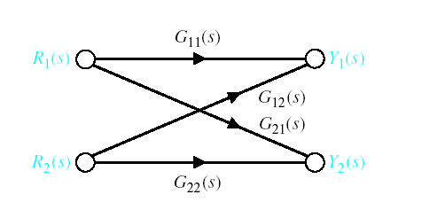
Signal-Flow Graph Models

Slide 5
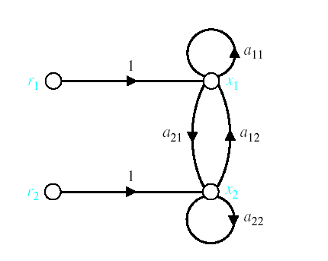
Signal-Flow Graph Models
r₁ and r₂ are inputs and x₁ and x₂ are outputs

Slide 6
Signal-Flow Graph Models
x_{o} is input and x₄ is output
f
c
x₀
x₁
x₂
g
x₃
x₄
a
d
h
b
e

Slide 7
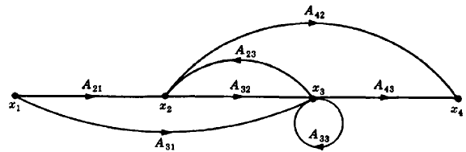
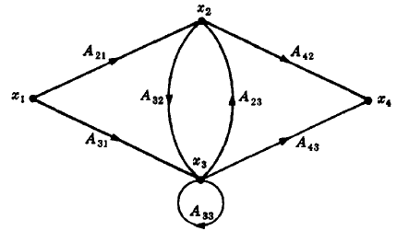
Construct the signal flow graph for the following set of simultaneous equations.
There are four variables in the equations (i.e., x₁,x₂,x₃,and x₄) therefore four nodes are required to construct the signal flow graph.
Arrange these four nodes from left to right and connect them with the associated branches.
Another way to arrange this graph is shown in the figure.

Slide 8
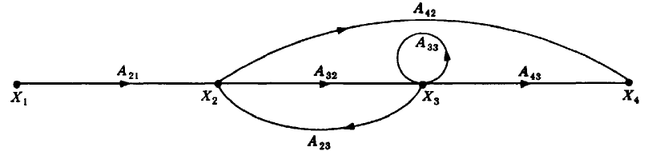
Terminologies
An input node or source contain only the outgoing branches. i.e., X₁
An output node or sink contain only the incoming branches. i.e., X₄
A path is a continuous, unidirectional succession of branches along which no node is passed more than ones. i.e.,
A forward path is a path from the input node to the output node. i.e.,
X₁ to X₂ to X₃ to X₄ , and X₁ to X₂ to X₄ , are forward paths.
A feedback path or feedback loop is a path which originates and terminates on the same node. i.e.; X₂ to X₃ and back to X₂ is a feedback path.
X₁ to X₂ to X₃ to X₄
X₁ to X₂ to X₄
X₂ to X₃ to X₄

Slide 9
Terminologies
A self-loop is a feedback loop consisting of a single branch. i.e.; A₃₃ is a self loop.
The gain of a branch is the transmission function of that branch.
The path gain is the product of branch gains encountered in traversing a path. i.e. the gain of forwards path X₁ to X₂ to X₃ to X₄ is A₂₁A₃₂A₄₃
The loop gain is the product of the branch gains of the loop. i.e., the loop gain of the feedback loop from X₂ to X₃ and back to X₂ is A₃₂A_{23.}
Two loops, paths, or loop and a path are said to be non-touching if they have no nodes in common.

Slide 10
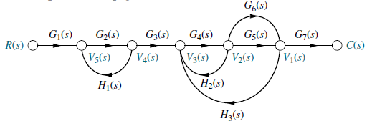
Consider the signal flow graph below and identify the following
Input node.
Output node.
Forward paths.
Feedback paths (loops).
Determine the loop gains of the feedback loops.
Determine the path gains of the forward paths.
Non-touching loops

Slide 11

Consider the signal flow graph below and identify the following
There are two forward path gains;

Slide 12
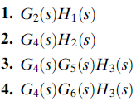
Consider the signal flow graph below and identify the following
There are four loops

Slide 13

Consider the signal flow graph below and identify the following
Nontouching loop gains;

Slide 14
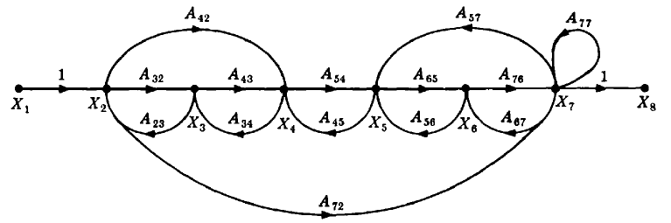
Consider the signal flow graph below and identify the following
Input node.
Output node.
Forward paths.
Feedback paths.
Self loop.
Determine the loop gains of the feedback loops.
Determine the path gains of the forward paths.

Slide 15
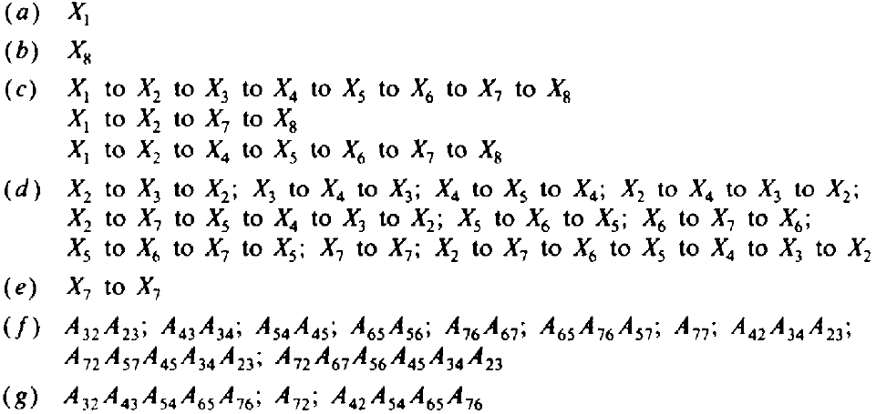
Input and output Nodes
Input node
Output node

Slide 16
(c) Forward Paths

Slide 17
(d) Feedback Paths or Loops

Slide 18
(d) Feedback Paths or Loops

Slide 19
(d) Feedback Paths or Loops

Slide 20
(d) Feedback Paths or Loops

Slide 21
(e) Self Loop(s)

Slide 22
(f) Loop Gains of the Feedback Loops

Slide 23
(g) Path Gains of the Forward Paths

